Slide 1
Welcome!
Thank you for participating in our experiment!
IMPORTANT: YOU MUST STAY IN FULL SCREEN MODE FOR THE ENTIRE
EXPERIMENT OR YOU WILL NOT BE PAID!
Your browser is now in full screen mode.
If you leave full screen mode for any reason, you will exit the experiment, and you will return to Prolific without payment. Please remain in full screen mode for the whole experiment, which will take approximately 30-40 minutes.

Slide 2
In this experiment you will learn to identify 8 different kinds of rocks,
like obsidian, pumice, etc.
If you do a good job learning to identify the rocks you will earn an additional $3 bonus payment.

Slide 3
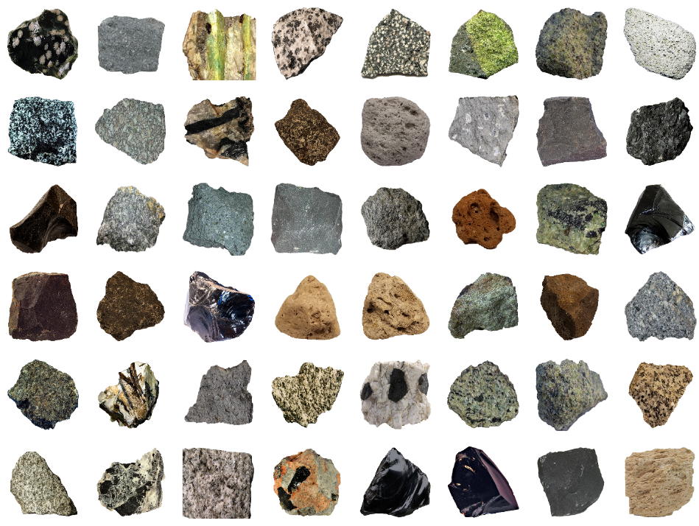
On each trial, you will start by seeing
a grid of rocks, like below.
These are examples of the rocks you will learn to classify.
On each trial, you will use the mouse to click on one of the rocks that you want to learn about.

Slide 4
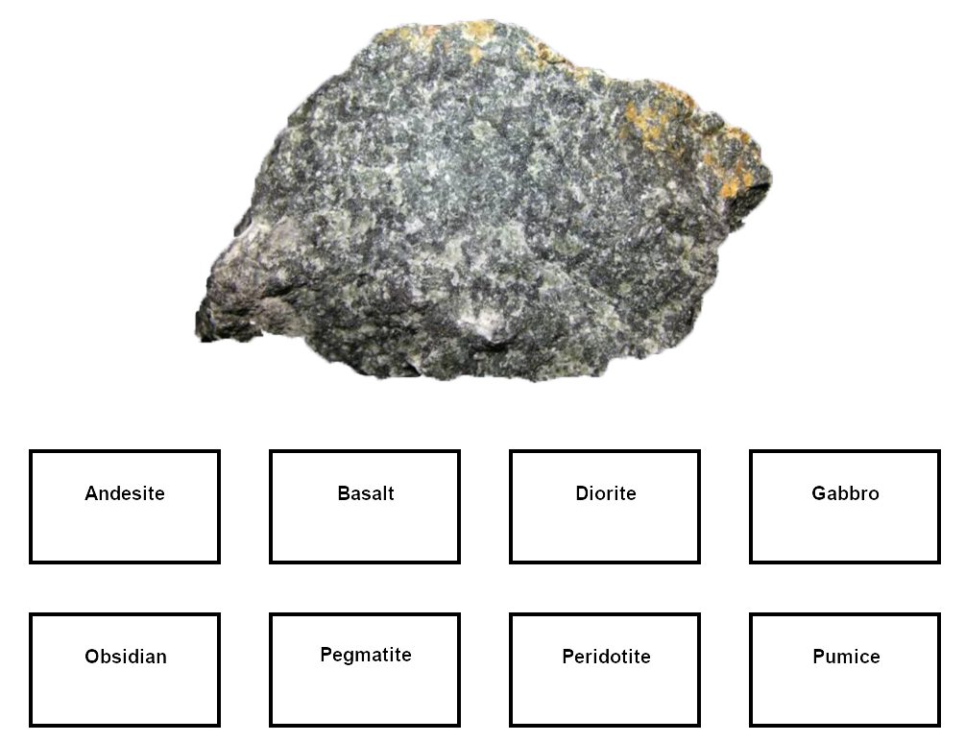
Then you will see an enlarged picture of the rock, with buttons on the screen with the different types, like below.
Make your best guess at identifying the rock by clicking one of the buttons. After you make your selection, the computer will tell you the correct answer.

Slide 5
At first you will be guessing, but by paying attention to the rocks and the correct answers provided by the computer, you should gradually learn to identify the rocks.

Slide 6
After each of the training blocks that we
just described, you will be tested on
what you have learned in a test block. We will explain the test blocks after you complete your first training block.
The experiment consists of 9 cycles of
training and test blocks,
with 16 trials per each block.

Slide 7
Your goal is to learn to correctly classify the rocks into as many of the 8 geological types as you can during the TEST blocks.
The TRAINING blocks are there to help you learn the rock categories, but your performance during the training blocks is not being recorded by the computer.

Slide 8
On each trial of learning, we will give you a recommendation of which rock to choose by placing a square around it.
The recommendation is based on what we think will be the best choice to help you learn the categories. You may choose to follow our recommendation or select another rock that you feel is more useful.
Notes:
xxxxx

Slide 9
Important!
The $3 bonus payment is based only on your TEST performance during the final three test rounds of the study. Your answers during TRAINING trials do not matter for the bonus payment.
Reminder: Stay in full screen mode throughout the full study. If you exit full screen mode you will return to Prolific, and no compensation will be provided.

